Slide 1
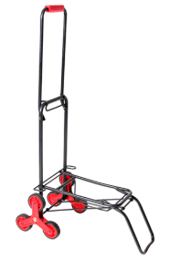
Midpoint Presentation
Portable Carrier B
Team F1827
Saleh Alotaibi - Project Manager
Abdalaziz Alhelfy - Web Developer
Abdullah Alfaraj- Document Manager
Ahmad Almutairi- Budget Liaison
Figure 1: Simple Portable Carrier [1]
Abdalaziz Alhelfy
03/14/2019
C5 - Portable Carrier B

Slide 2
Overview
Project Description
1.1. Clients and Sponsorship
1.2. CAD Model
1.3. Image of the Design
Updates
2.1. What has been accomplished?
2.2. Changes/Causes
2.3. Visual Evidence
Moving Forward
3.1. Analytical Analysis
3.2. What is left in the manufacturing?
3.3. Detailed plans of manufacturing
3.4. Detailed plans for testing
Schedule & budget
Conclusion & Future Work
References
Abdalaziz Alhelfy
03/14/2019
C5 - Portable Carrier B

Slide 3
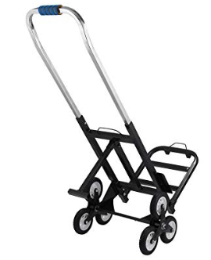
Project Description
One major problem after grocery shopping, is transporting the bags from your car to your house.
The number and heaviness of the bags can make you do many trips from your car to your house.
Living on high floors with no elevator, will take much effort and more time in order to transport the bags.
Without any doubt, the portable carrier is an option to overcome this issue.
Figure 2: Simple Portable Carrier [2]
Abdalaziz Alhelfy
03/14/2019
C5 - Portable Carrier B

Slide 4
Project Description (Cont’d)
Clients and Sponsorship
Clients:
Dr. Moghaddam
Technical Advisor:
Dr. Trevas
Stakeholders:
People with disabilities
Shopping lovers
Sponsor:
Mechanical Engineering Department
Abdalaziz Alhelfy
03/14/2019
C5 - Portable Carrier B

Slide 5
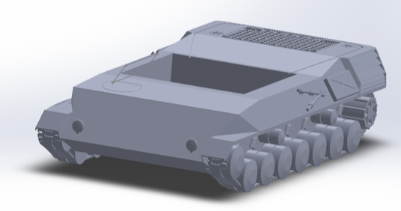
Project Description (Cont’d)
CAD MODEL
storage tank
Tank Threads
pin
motors
Wheels
Figure 3: Computer Aided Design Draft
Ahmad Almutairi
03/14/2019
C5 - Portable Carrier B

Slide 6
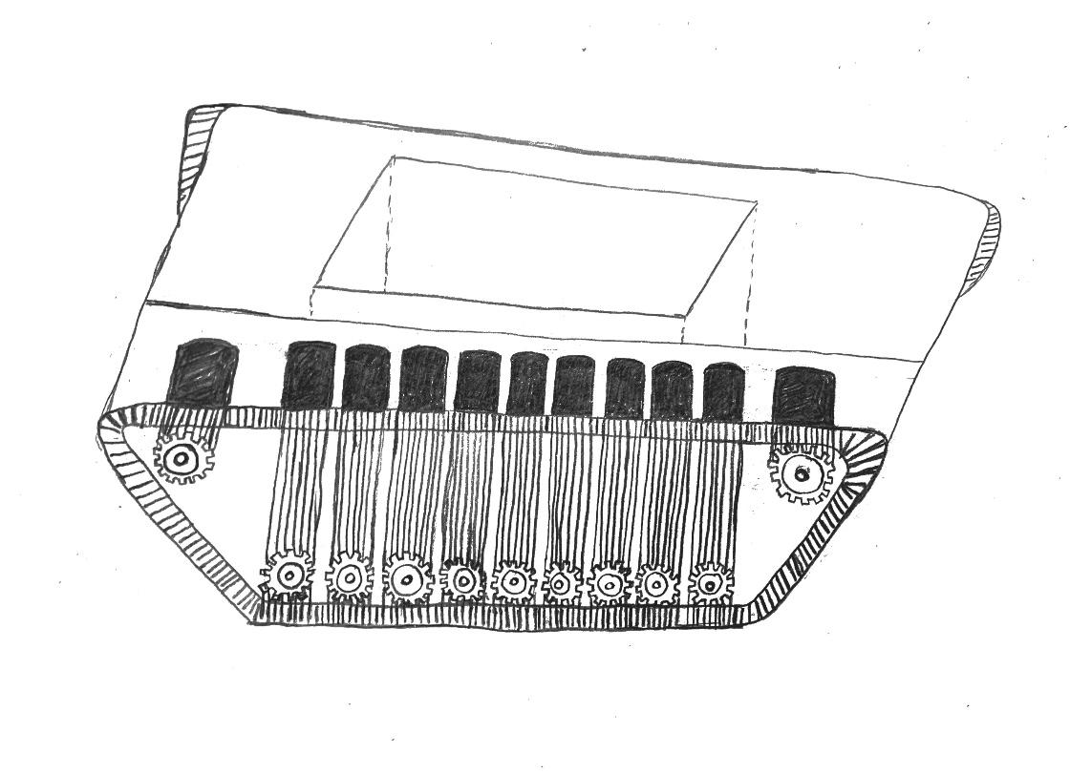
Project Description (Cont’d)
Image of the Design
Storage tank
Motor
3D Wheels
Tank Threads
Figure 4: Sketch of our design
Abdullah Alfaraj
03/14/2019
C5 - Portable Carrier B

Slide 7
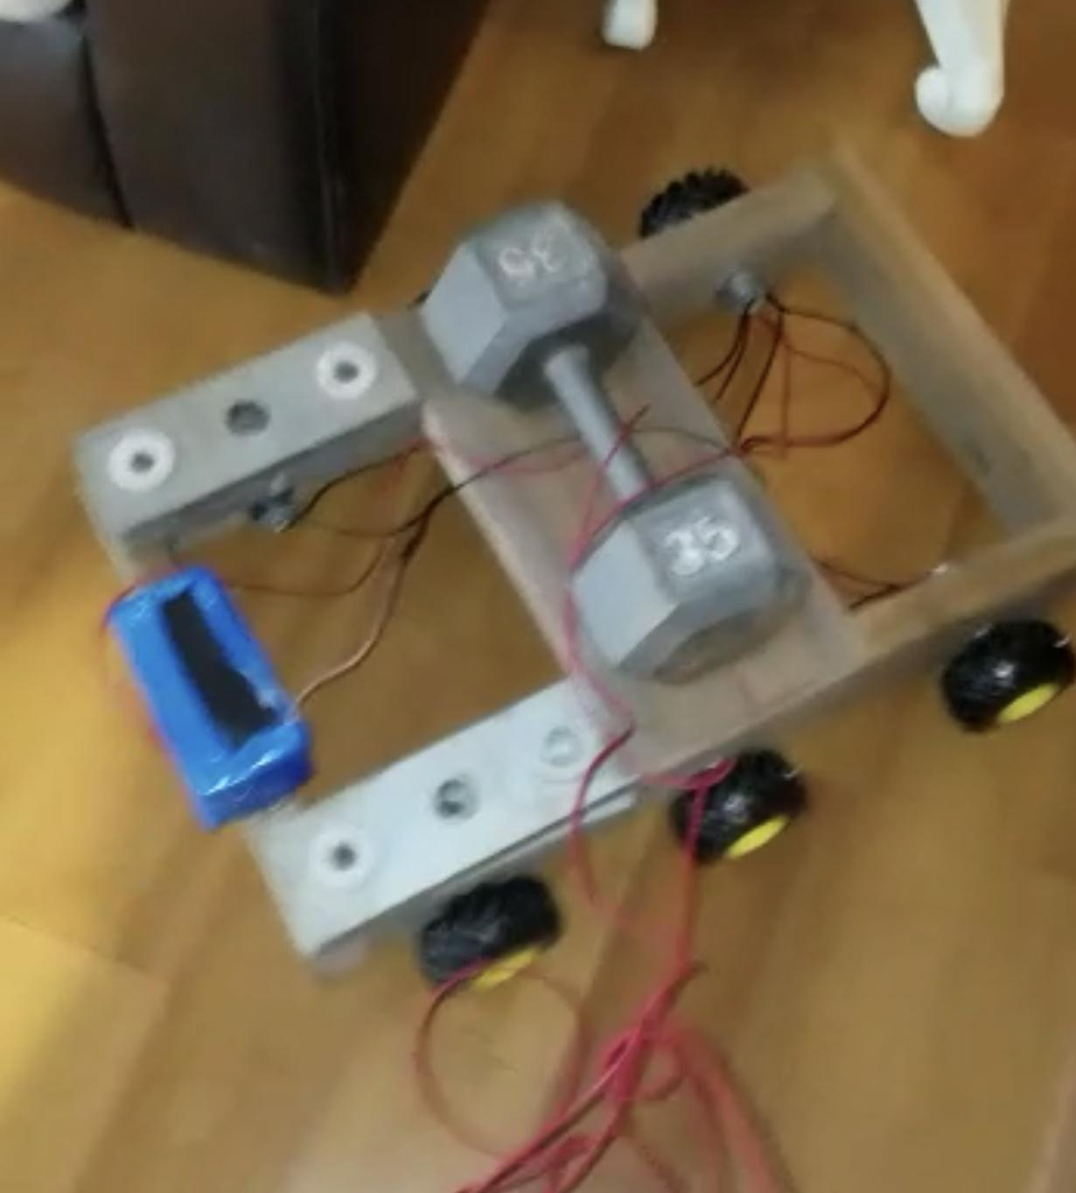
Updates
What has been accomplished since last presentation?
The team has purchased all of the needed materials.
The team has made a small prototype to check how the material are going to work with each other, and to figure out any problem that we might face.
The prototype was made as a wooden shape, 6 motors, 12V battery, microcontroller (programmed) with 4 channels relays equivalent to the arduino.
Figure 5: Protoype
Ahmad Almutairi
03/14/2019
C5 - Portable Carrier B

Slide 8
Updates (Cont’)
Table 1: Changes and causes of these changes
Changes | Causes
Adding more motors | We need more torque, since after testing the prototype, we figured out that it needs more force to go up on incline ramps.
Adding more wheels | We will need more wheels, since our actual design will be bigger than the prototype that we made.
Adding the idea of winching instead of the hydraulic legs. | The hydraulic will add more weight to our design.
Abdullah Alfaraj
03/14/2019
C5 - Portable Carrier B

Slide 9
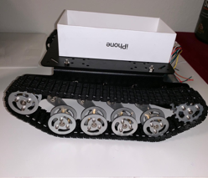

Updates (Cont’d)- Visual Evidence
Figure 6: Prototype from Fall 2018
Figure 7: Prototype Testing
Saleh Alotaibi
03/14/2019
C5 - Portable Carrier B

Slide 10
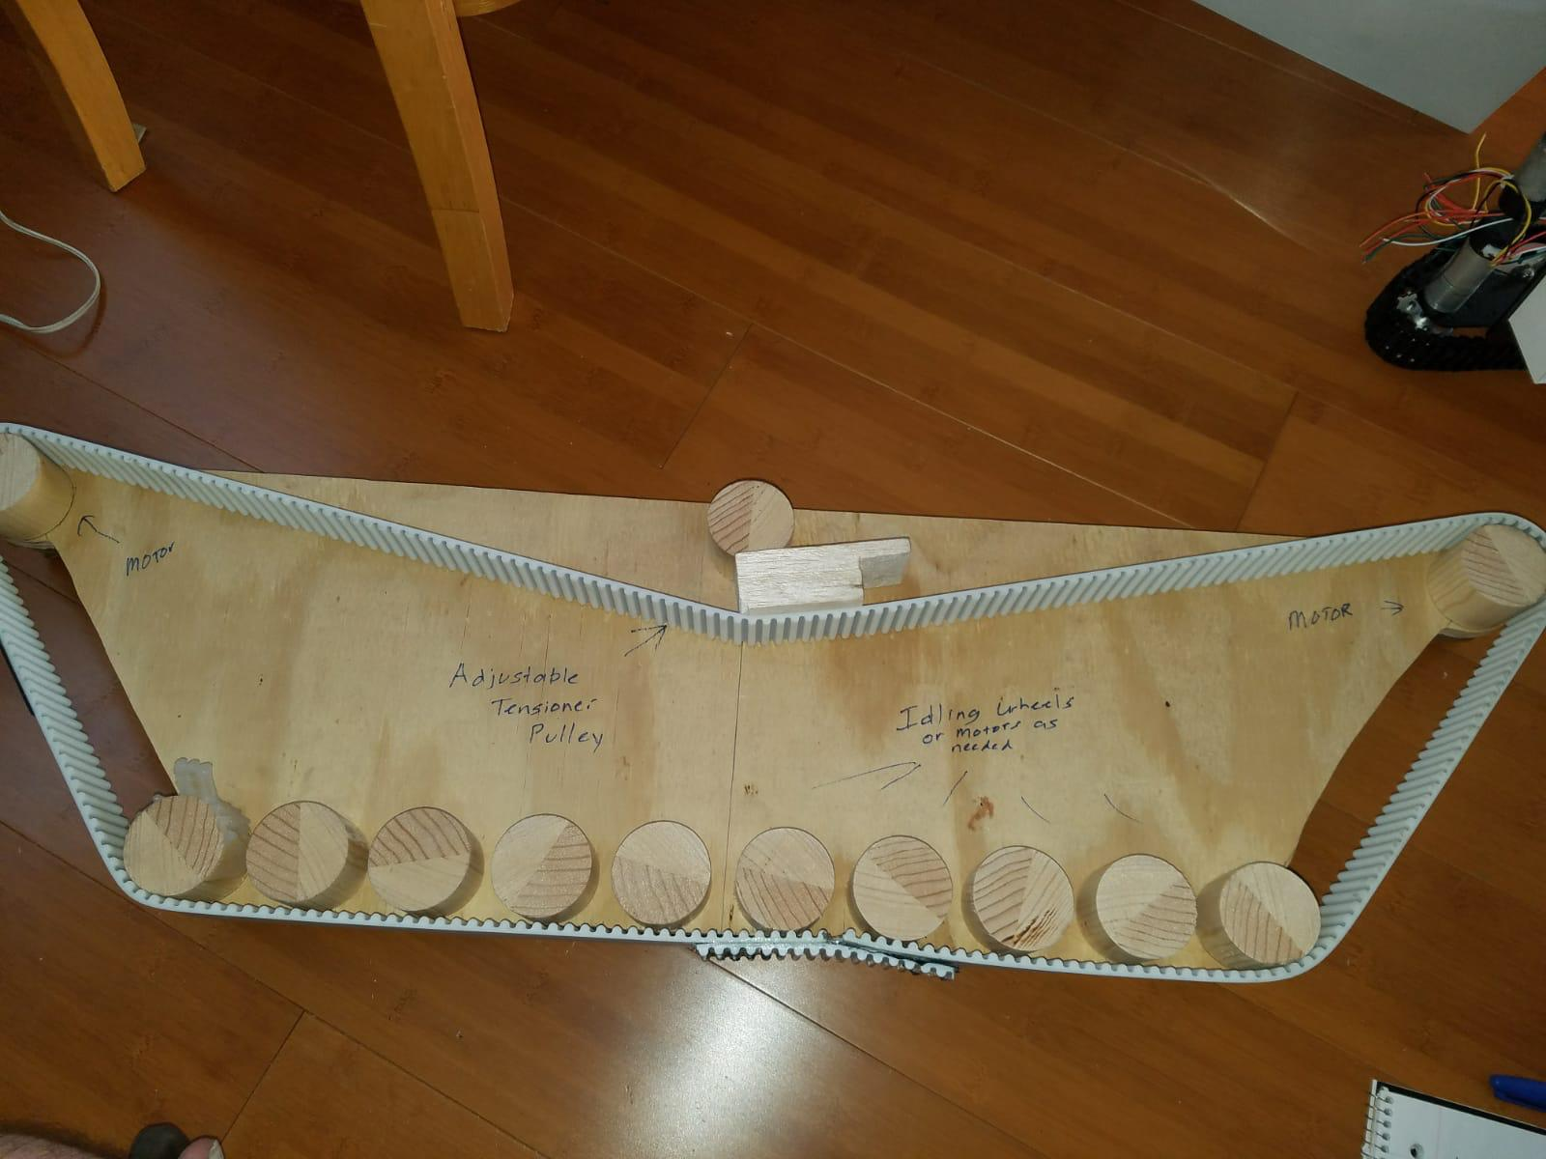
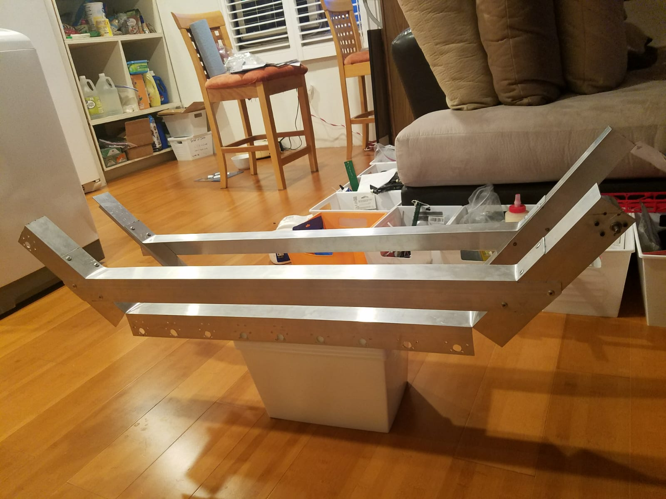
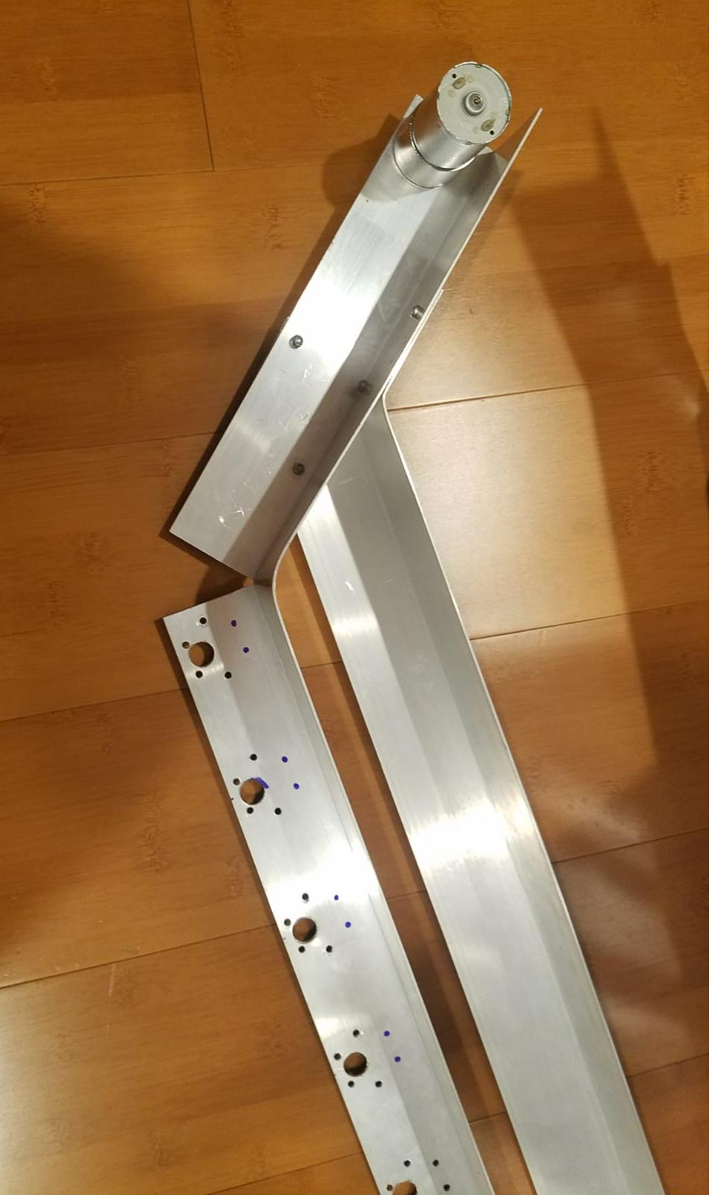
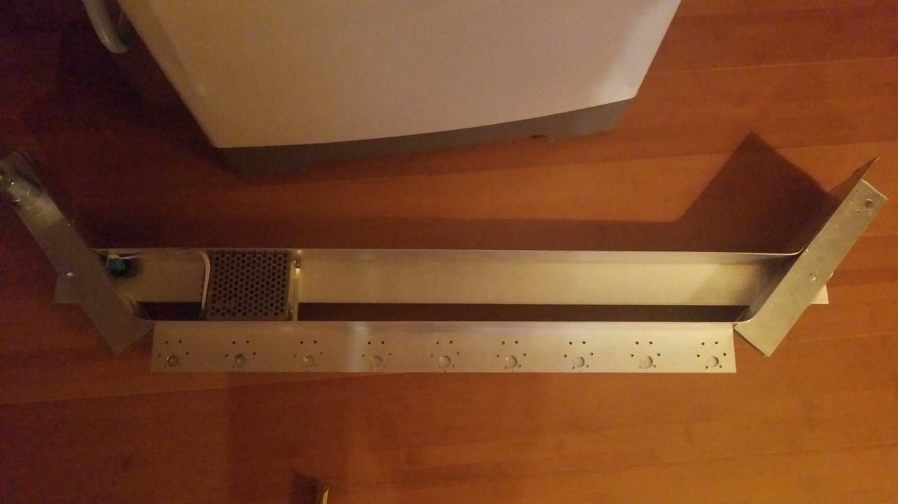
Updates (Cont’d)- Visual Evidence
Figure 9: Two sides of the device
Figure 8: Tank thread
Figure 11: Installing the motors
Saleh Alotaibi
03/14/2019
C5 - Portable Carrier B
Figure 10: inner part of the side

Slide 11
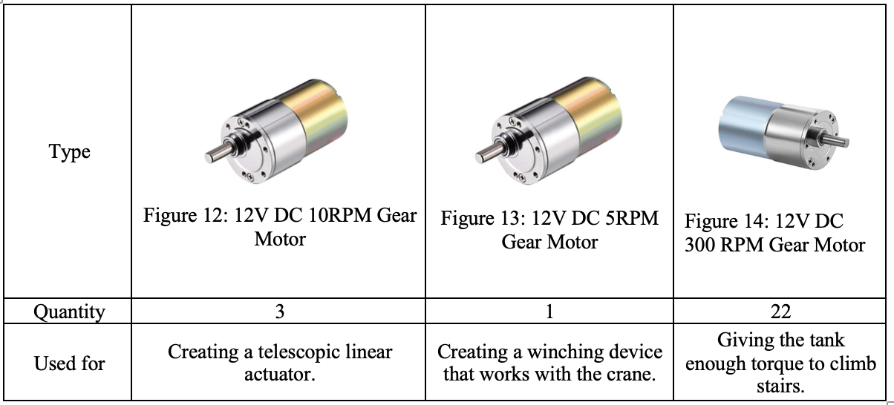
Moving forward
Motors Analytical Analysis
Table 2: Motors types
Ahmad Almutairi
03/14/2019
C5 - Portable Carrier B

Slide 12
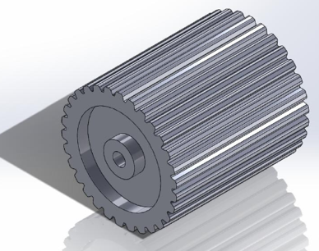
Moving forward (Cont’d)
Wheels/Belt Analytical Analysis
Tank threads have the capability to move on any sort of terrain therefore we have decided to use tank threads by using the conveyor belt.
They are 22 wheels of a 3D printed and we will use it in manufacturing the device.
Wheels teeth will match the belt teeth perfectly to let the device move.
So, the dimension for the wheels will be the same as the belt (2-inch).
They should be Solid & the D-shaped hole matches the shape of the axle of the motor.
Figure 15: Isometric View
Figure 16: Tank threads
Abdullah Alfaraj
03/14/2019
C5 - Portable Carrier B

Slide 13
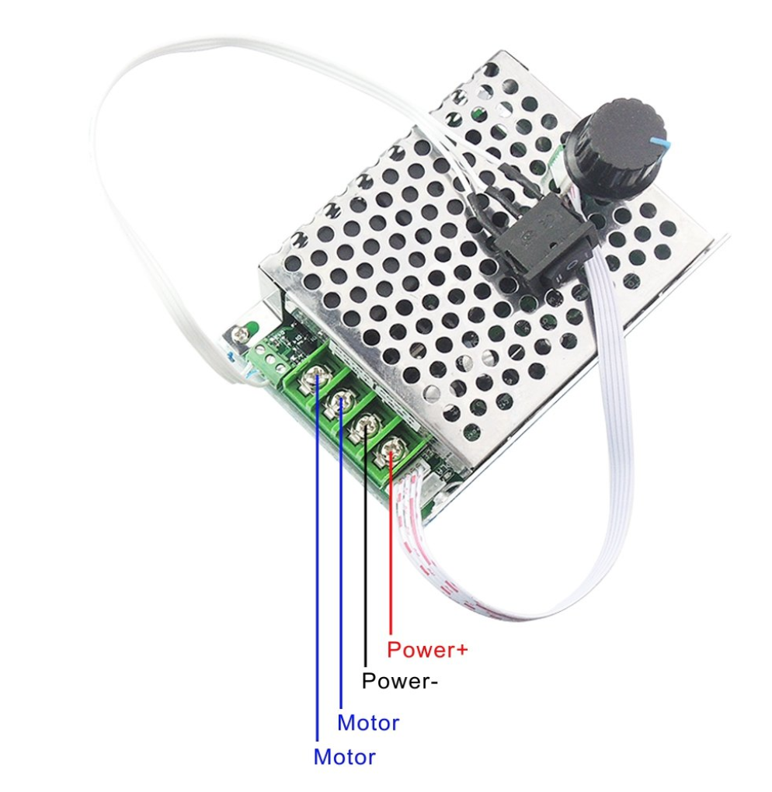
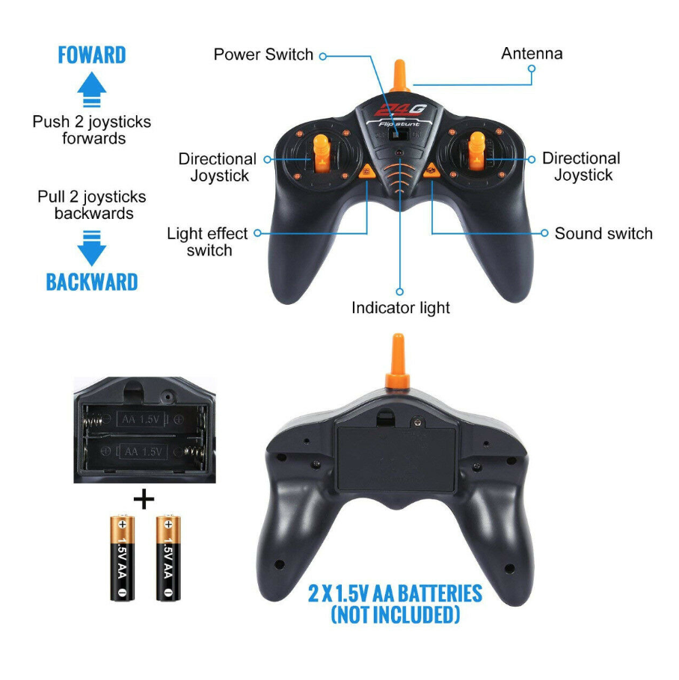
Moving forward (Cont’d)
Controlling Analytical Analysis.
Programmed microcontroller from a used toy with a four channel relay.
The signals from the Microcontroller (Receiver) will go to the relay.
There are 4 relays. Two for each sides, one controlling each direction.
It will independently control each side of the device forward and reverse.
Speed controller will be needed for each motor to dial in the perfect speed.
these will also control clockwise and counterclockwise motion for the motors for forward and reverse.
Figure 18: Speed controller
Figure 17: RC Remote controller
Saleh Alotaibi
03/14/2019
C5 - Portable Carrier B

Slide 14
Moving forward (Cont’d)
- What is left in the manufacturing of the design?
Finish the frame of the carrier.
Install the motors.
Install the wheels.
Install the threads.
Wiring all the motors and controllers.
Changing the metal cable of the winch with the nylon tow.
Cover the tank with sheet of metal to make a storage compartment and a skid plate of the bottom.
Abdullah Alfaraj
03/14/2019
C5 - Portable Carrier B

Slide 15
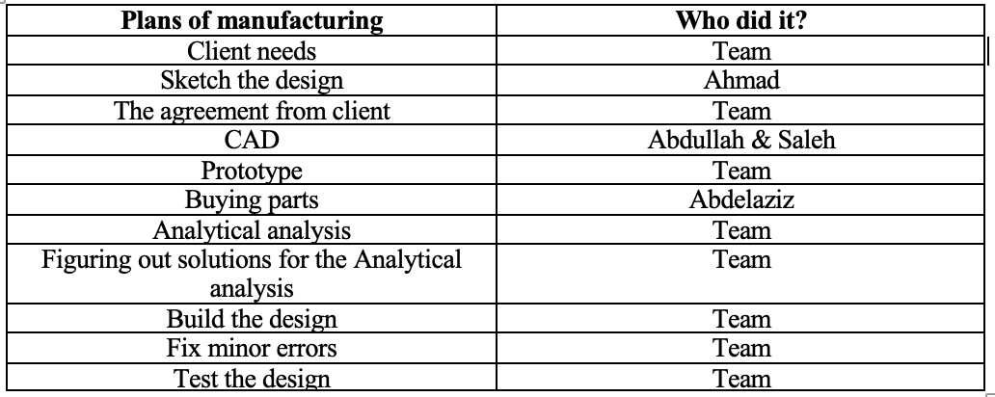
Moving forward (Cont’d)
-Detailed plans of manufacturing.
Table 3: Plans of manufacturing
Saleh Alotaibi
03/14/2019
C5 - Portable Carrier B

Slide 16
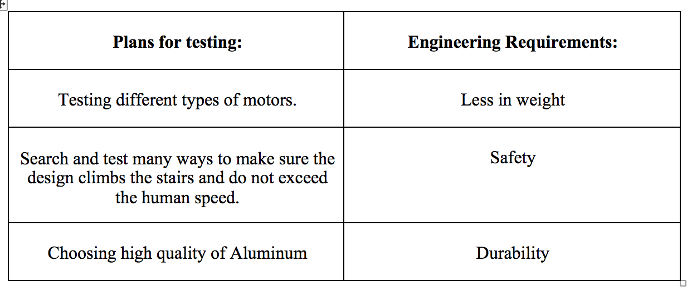
Moving forward (Cont’d)
- Detailed plans for testing the design.
Table 4: Plans for testing
Abdalaziz Alhelfy
03/14/2019
C5 - Portable Carrier B

Slide 17
Schedule & Budget
Table 5: Budget
Expense Details | Cost
Total Budget | $1000
Anticipated Expenses | $836
Actual Expenses | $1086.04
Resulting Balance | $0
Ahmad Almutairi
03/14/2019
C5 - Portable Carrier B

Slide 18
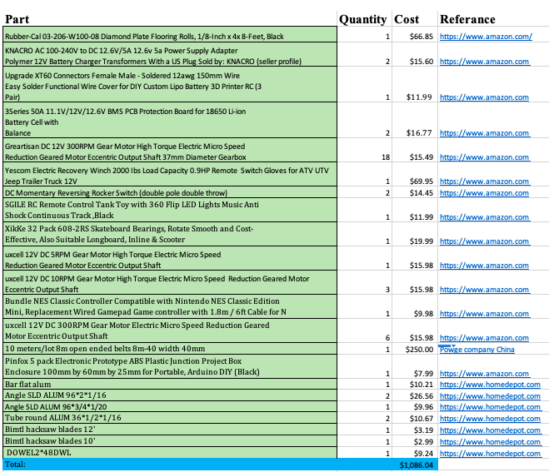
Budget
Ahmad Almutairi
03/14/2019
C5 - Portable Carrier B

Slide 19
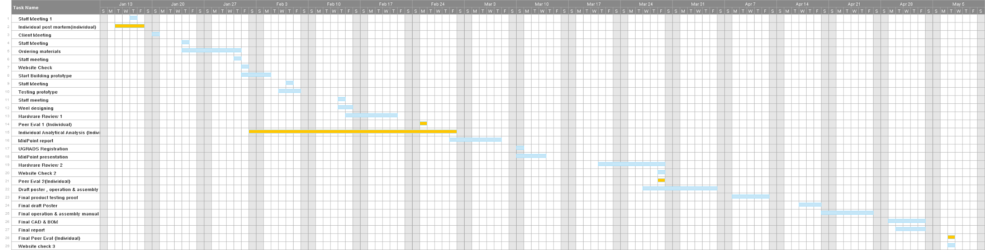
Gantt Chart
Abdalaziz Alhelfy
03/14/2019
C5 - Portable Carrier B

Slide 20
Conclusion & Future Work
Conclusion:
Team has developed the actual design by changing the model of the parts to be more efficient, and the team is on track of the schedule.
Future Work:
Work on the hand
install the remaining parts
Abdalaziz Alhelfy
03/14/2019
C5 - Portable Carrier B

Slide 21
References
[1] Formost, “Portable Carrier”, available [online], https://www.google.com.pk/url?sa=i&rct=j&q=&esrc=s&source=images&c.
[2] Carr, N. R. (1991). U.S. Patent No. 5,003,748. Washington, DC: U.S. Patent and Trademark Office.
[3] Remote control smart robot toy, Available [online], https://www.aliexpress.com/item/DIMEI-9007A-2-4G-Wireless-Remote-Control-Smart-Robot-Dog-Kids-Toy-Intelligent-Talking-Robot-Dog/32888447312.html?aff_platform=promotion&cpt=1540345878482&sk=rJYNbUv&aff_trace_key=aed290e0525d4bd891132f071416f28a-1540345878482-05728-rJYNbUv&terminal_id=ea20761b9d3348caa88a632935caefb8
[4] Electric beach wagon, Available [online], http://electricbeachwagons.com/
[5] Komatsu hydraulic excavators, Available [online], https://www.komatsuamerica.com/equipment/excavators

Slide 22
References (Cont’d)
[6] RC Remote Controller,, Available [online], https://www.ebay.com/itm/RC-Remote-Control-Tank-Toy-360-Flip-LED-Lights-Music-Anti-Shock-Continuous-Track-/173629064153?_trksid=p2349526.m4383.l4275.c10#viTabs_0
[7] Speed controller, Available [online],
https://www.amazon.com/gp/aw/d/B01M26YWXZ/ref=ox_sc_act_image_1?smid=AFAJ27QUDKWR8&psc=1
[8] DC 12V 300 RPM Motor, Avaialble [online],
https://www.amazon.com/gp/aw/d/B072N84V8S/ref=sspa_mw_detail_1?ie=UTF8&psc=1.
[9] Tank thread, Available [online],
https://rover.ebay.com/rover/0/0/0?mpre=https%3A%2F%2Fwww.ebay.com%2Fulk%2Fitm%2F322056857405.

Slide 23
Questions?

